Slide 1

Digital Payment Fraud Detection System
MySQL Database Project
Store payment info and check suspicious transactions.
Project By:K.Sampath

Slide 2




OVERVIEW
Project Overview
DigitalPaymentFraud is one MySQL database for customers, payments and fraud checks.
Customers
Transactions
Fraud analysis
Customer and account details are kept in one place.
Payment info can be saved and checked.
Suspicious activity is tracked with alerts and investigations.
DIGITALPAYMENTFRAUD DETECTION
MYSQL

Slide 3


WHY WE BUILT IT
The Problem & Our Solution
Fraud is hard to spot when payment data is spread across many places.
Problem
Solution
→
Fraud is hard to track.
Payment data gets spread out.
Suspicious activity is hard to connect.
One MySQL database connects customers, transactions and fraud records.
Risk assessments → alerts → investigations

Slide 4



PROJECT OBJECTIVES
Build a reliable fraud-analysis foundation
Six goals guide the database design.
Organise
Manage
Store
Payment information
Customer accounts
Transaction records
Record
Track
Analyse
Fraud alerts
Risk assessments
Transaction data

Slide 5





HOW THE SYSTEM WORKS
How the System Works
Each record helps with the next decision.
Customer
Account
Transaction
Owns an account
Links to payments
Records the payment
Risk assessment
Fraud alert
Investigation
Checks how risky it is and scores it
Flags odd activity
Tracks follow-up

Slide 6

DATABASE DESIGN
15 tables in three groups
Each table handles one part of payments and fraud checks.
Data Is divided into 3 branches so that storing and retrieving data can be done easily
PEOPLE & ACCOUNTS
PAYMENT ACTIVITY
FRAUD MANAGEMENT
Core Branches
Payment
Risk Detection
Customers
Banks
Accounts
Devices
Locations
Merchants
Merchant_Categories
Payment_Methods
Transactions
Login_Events
Fraud_Rules
Risk_Assessments
Fraud_Alerts
Investigations
Chargebacks

Slide 7
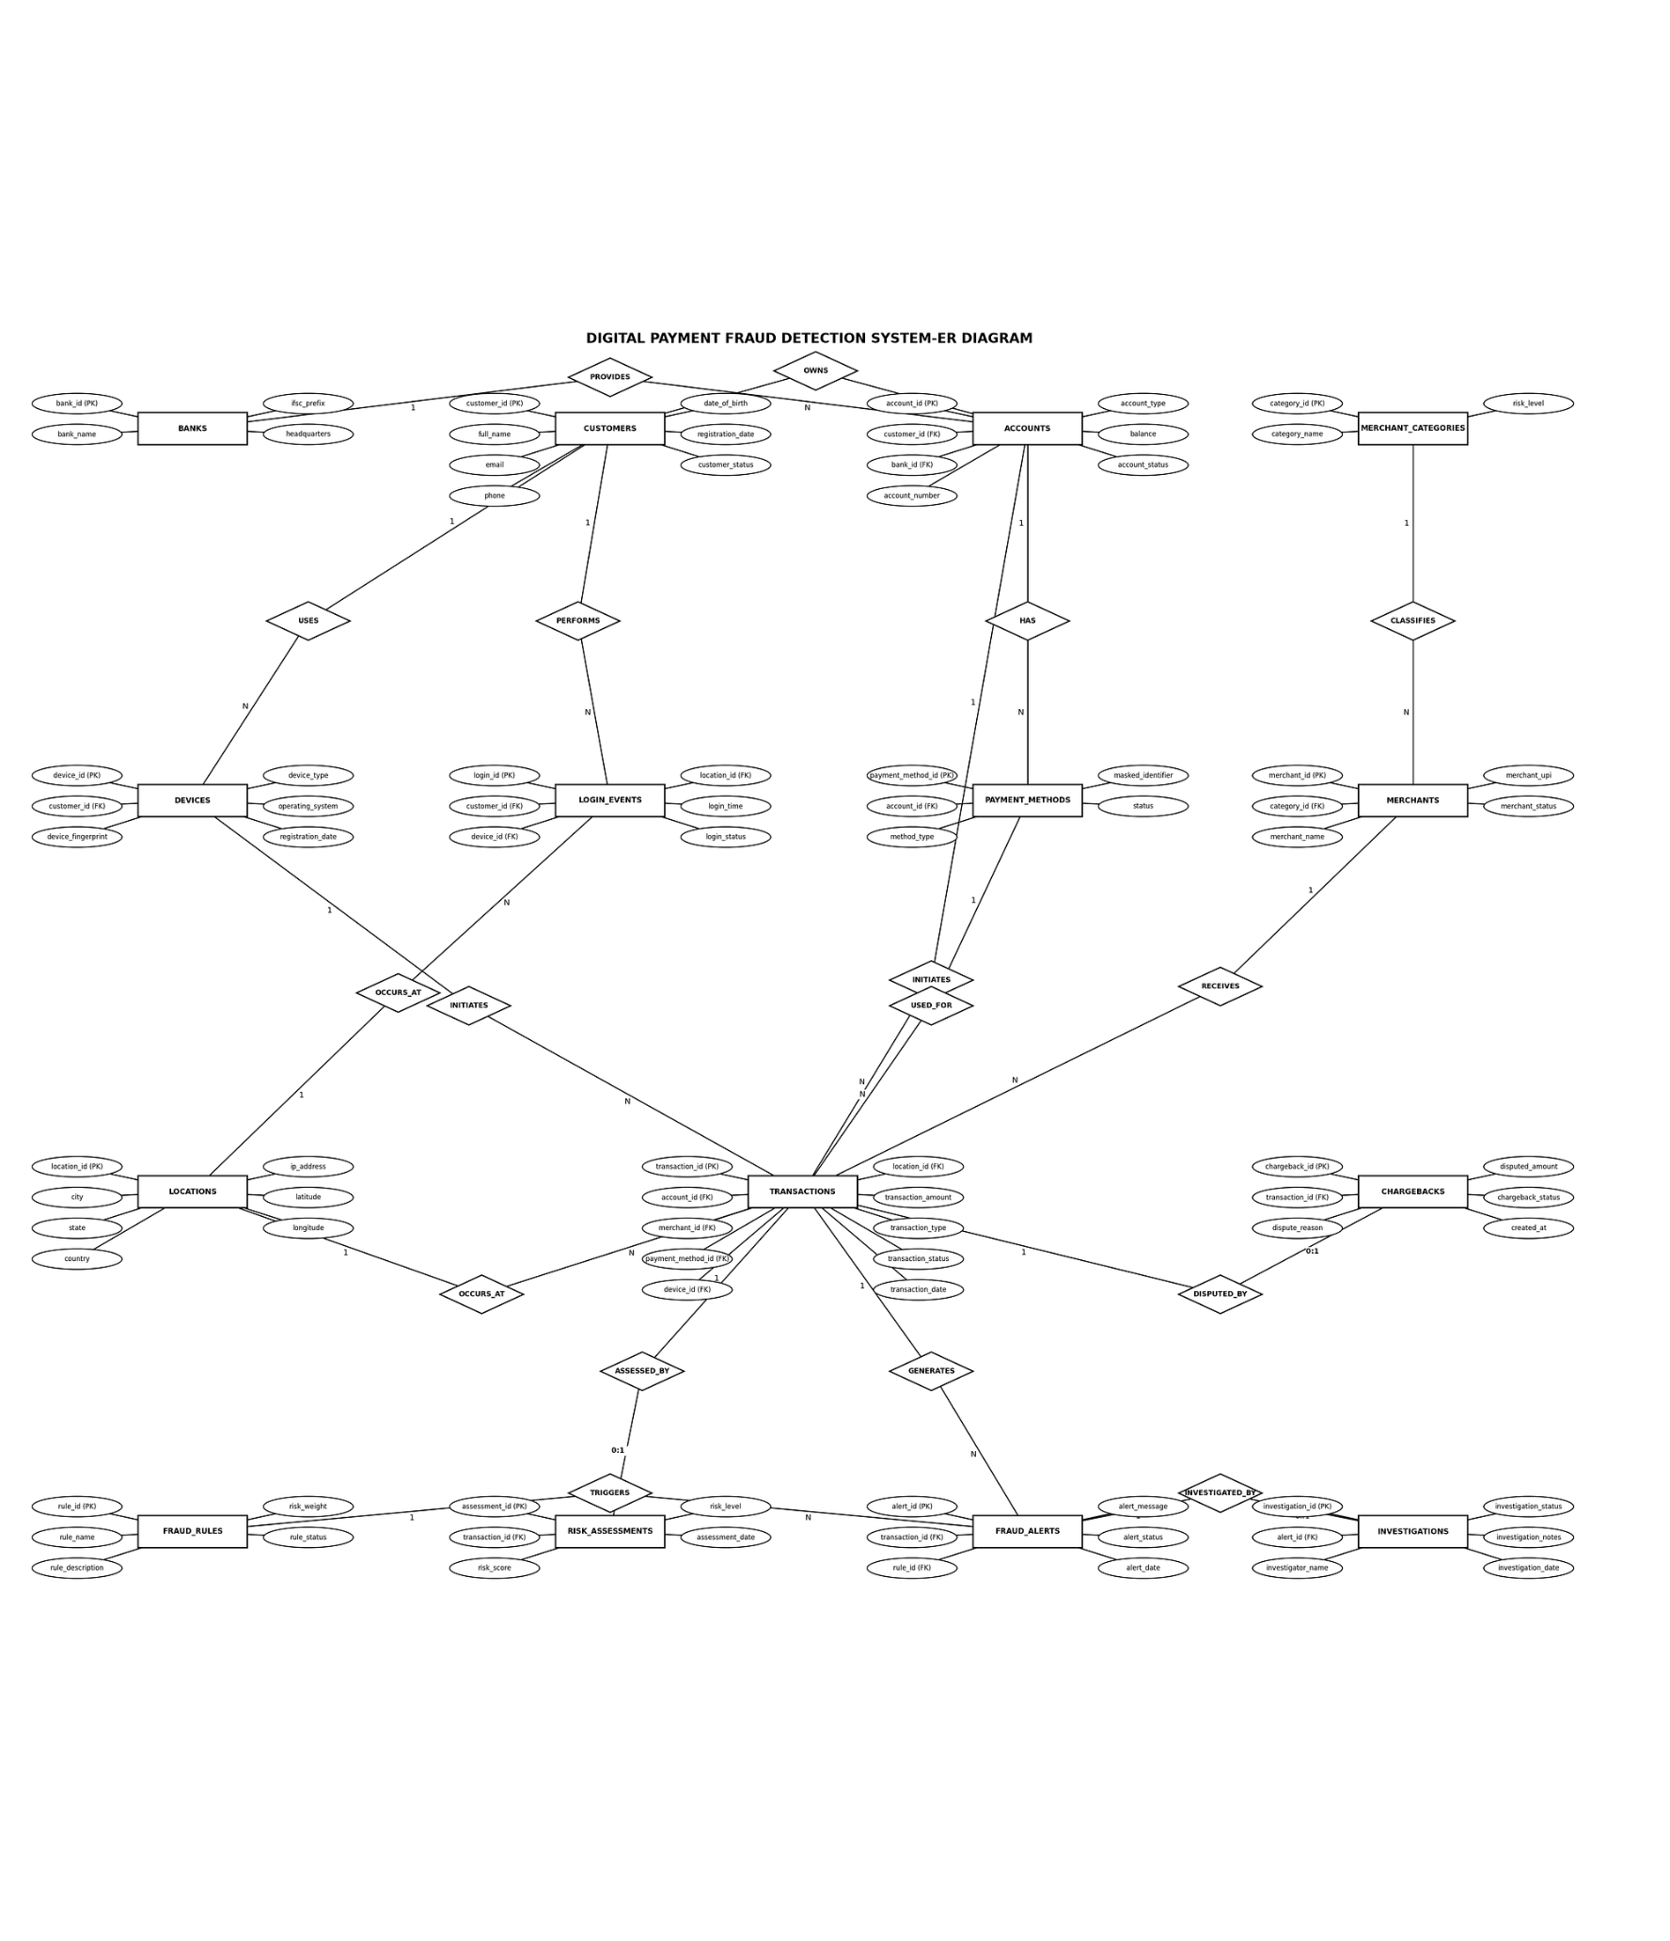



DATABASE RELATIONSHIPS
Database Relationships
15 connected tables
Primary keys and foreign keys link records.
Customers, accounts, transactions and fraud records connect through the model.

Slide 8

SQL ANALYSIS
What the Database Can Do
View customer transactions and store them
Find high-value transactions and analyze them
Check failed transactions
Check alerts and risk levels

Slide 9


WHAT IS DONE?
The database and its checks are ready.
15
ER
Data
MySQL tables made
Diagram made
Sample records added
SCHEMA
RELATIONSHIPS
SAMPLE DATA

Slide 10


Future Scope & Conclusion
In future this database can be connected to a optimal Frontend and Backend so that tracinkg of fraud transactions and risk analysis can be done easily and accurately
Future Scope
CONCLUSION
Live fraud checks
Machine learning to predict fraud
A solid base for safer payment checks.
Automated alerts
🌐︎
Web application
This database gives us a solid base to store payments and spot suspicious ones.
MYSQL
FRAUD ANALYSIS

